Slide 1
Digital Class MA 3rd Semester Department of Political Science Paschim Guwahati Mahavidyalaya, Dharapur
Course Title: Democracy and Multiculturalism Course Code: POL3086
Today's Topic: Differentiated Citizenship: A Critique of the Ideal of Universal Citizenship (Based on Iris Marion Young's 1989 essay)
Date: 18th August 2025 Class Taken by: Humen Boruah

Slide 2
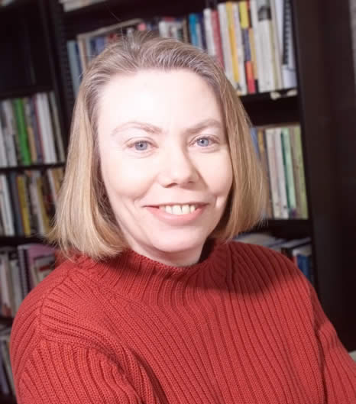
Title: Polity and Group Difference: A Critique of the Ideal of Universal Citizenship Author: Iris Marion Young Published in: Ethics, 1989

Slide 3
What is a Social Group?
🔍 Not just a demographic label — but a historically constructed identity.
✅ Defined by:
Shared experience
Cultural practices
Common social position
Examples Young gives:
Women, Blacks, LGBTQ+, elderly, disabled, linguistic/cultural minorities

Slide 4
Citizenship as Generality
▪ The Problem:
Modern thinkers (like Rousseau) argued that citizens must transcend group identities to pursue the “general will.”
Citizenship meant sameness, ignoring differences in history, culture, or status.
▪ Consequences:
Women, Blacks, Indigenous people were excluded because Excluded from General Will:
Women (seen as emotional)
Cultural minorities (seen as too particular)
Indigenous people (seen as primitive)
Feminists argue: this idea of the public sphere was built around masculine norms (reason, restraint, independence).
Example:
Rousseau: Women should stay in the private realm because their desires and sexuality disrupt the rational public order.

Slide 5
Differentiated Citizenship as Group Representation
️ Main Argument:
True participation requires acknowledging group difference, not suppressing it.
People come from different social locations, which shape their perspectives.
Asking everyone to be “neutral” silences oppressed groups.
What is a “Social Group”?
Not a club or association — but a shared identity shaped by history, culture, and social status.
Examples: Women, Blacks, LGBTQ+, elderly, disabled, poor, etc.

Slide 6
Five Faces of Oppression
Exploitation – Labor benefits others
Marginalization – Social exclusion
Powerlessness – No authority or respect
Cultural Imperialism – Stereotyping & invisibility
Violence – Systematic fear, threats, attacks
Link to Cultural Minorities:
Often face cultural imperialism (e.g., forced assimilation, language loss)

Slide 7
Proposal:
Young proposes group representation in public decision-making bodies:
Support for self-organization of groups.
A space to voice group-specific needs.
Even veto rights on policies directly affecting the group.

Slide 8
Universal Rights and Special Rights
▪ Key Argument:
Equal treatment often favors the dominant group, because the rules reflect their norms.
To achieve real equality, some groups need special rights.

Slide 9
🟨 Examples of Special Rights:
Pregnancy and maternity leave: Should be seen as a normal function, not a disability.
Disability rights: Modify workplace and policies to include disabled people.
Elder rights: Part-time or flexible work for senior citizens.
Affirmative action: To balance biased evaluation and hiring practices.
Bilingual education: Cultural minorities should learn in their own language.
Land rights for Indigenous people.

Slide 10
✅ Aim of Special Rights:
Not to give "extra" privileges.
But to correct structural disadvantages and include everyone fairly.
To denormalize the dominant group’s standards.

Slide 11
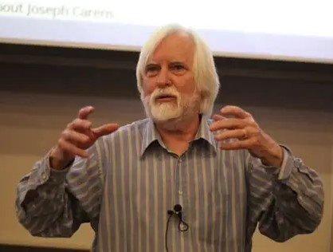
Criticisms of Differentiated Citizenship
Academic Critique: Emphasizing Group Difference Risks Fragmentation
Critics argue that promoting differentiated rights and group-specific identities may contribute to social fragmentation and weaken national integration.
Joseph Carens cautions that if politics becomes about
institutionalizing difference, it may damage shared identities and empathy among citizens, undermining mutual trust and collective responsibility.

Slide 12
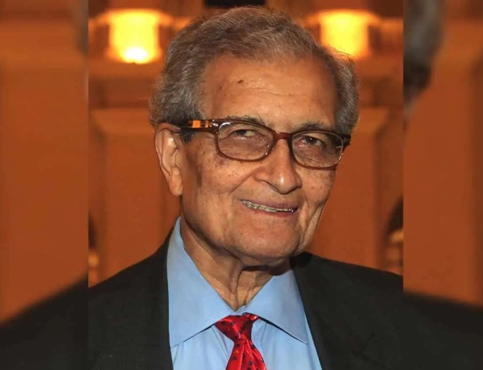
Lack of Integration & Overemphasis on Identity
Critics like Amartya Sen argue that –
too much focus on cultural identity may cause individuals to see themselves—and others—solely through that lens, resulting in rigid group boundaries and hindering broader cooperation. Political Science Institute
Additional concerns include that racial or cultural essentialism might solidify divisions rather than foster pluralistic solidarity.

Slide 13
Conclusion
The ideal of universal citizenship — equal rights, same treatment — is not enough.
In a diverse and unequal society, it often means forcing everyone to conform to dominant norms.
Instead, we need differentiated citizenship that:
Recognizes diversity,
Ensures group representation, and
Grants special rights to correct inequality.
Justice requires not sameness, but inclusion through recognition of difference.

